Slide 1

A U G M E N T E D
REALITY
A P R I L 2 0 2 3

Slide 2

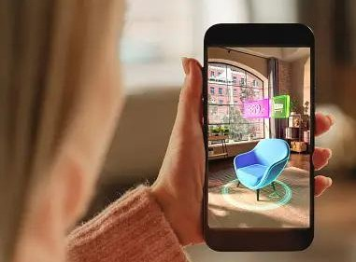


About Project
Augmented Reality (AR) seamlessly blends digital information with the
physical perception
world,
and
enhancing our interaction with
reality. Through the use of devices
like smartphones or AR glasses,
a layer of
users can experience
digital content overlaid onto their surroundings in real-time.

Slide 3
Our Team
VIVEK 2022BCY0028
UDAY 2022BCY0039
SYED IMTIAZ 2022BCY0006
KAMALAKAR 2022BCY0050
SAI MANOJ 2022BCY0017
ASIF 2022BCY0061

Slide 4




Our services
Enhanced Visualization
Augmented reality projects provide enhanced visualization by overlaying digital information onto the real world. This can include 3D models, data visualizations.
Interactive Experiences
AR projects offer interactive experiences where users can engage with virtual elements in real-time. This interaction can involve gestures, voice commands, or other forms of input.
01
02
Spatial Mapping
Remote Assistance
03
04
Augmented reality projects can leverage spatial mapping technology to create detailed maps of physical environments.
AR projects enable remote assistance and collaboration by allowing users to share their augmented reality view with others in real-time.

Slide 5
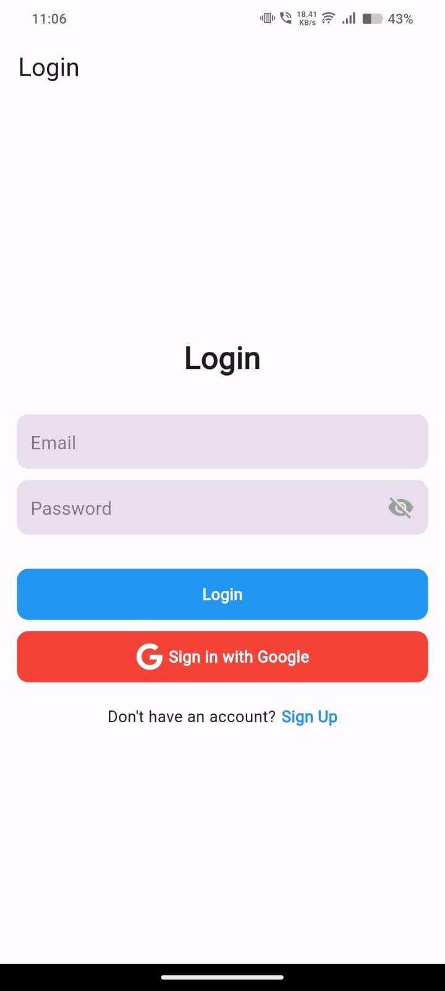
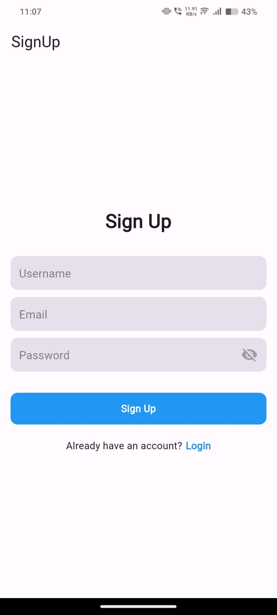


Slide 6
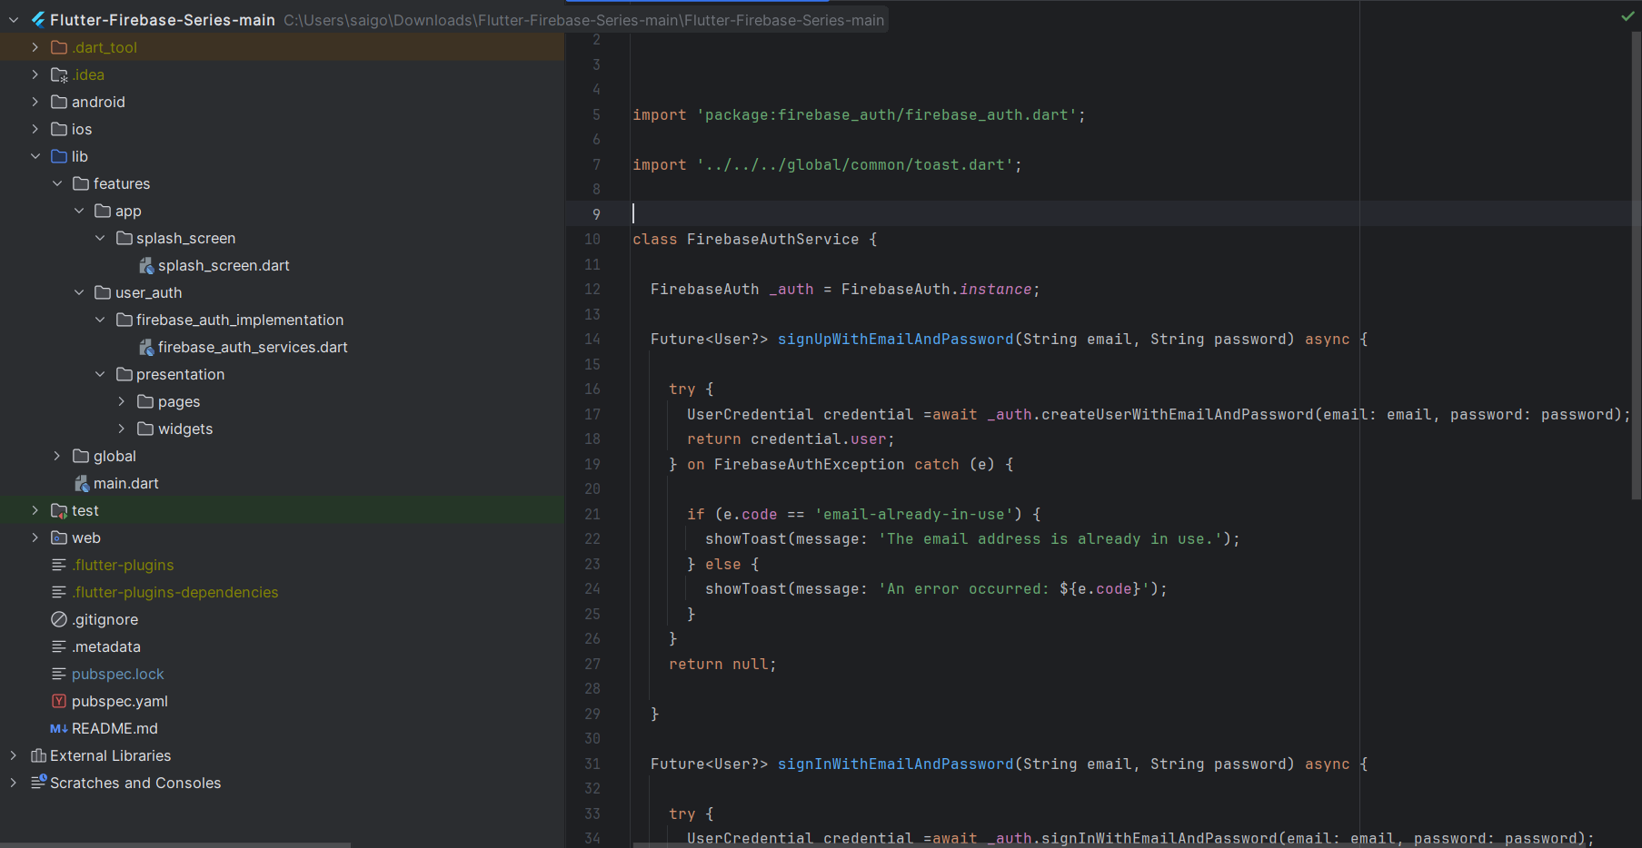
Firebase Authentication:

Slide 7


Our brand
MISSION
VISION
VALUES
The main mission of augmented reality (AR) is to seamlessly integrate digital information and virtual objects into the user's real-
The vision of augmented reality (AR) encompasses a future where digital information seamlessly integrates
The values of augmented reality (AR) extend beyond technological capabilities to encompass broader principles that shape its impact on individuals, society, and the world..
with the physical world, enhancing
world environment, enhancing their _{every aspect of our lives.}
perception and interaction with reality.

Slide 8

Objectives
Frontend With Flutter
Unity
Firebase
Utilizing Flutter for our frontend development has
Unity serves as the backbone of our augmented reality
Firebase Authentication adds a layer of security and trust to
provided us with a versatile and efficient toolset. Flutter's
experiences, providing powerful tools for 3D content creation, scene management,
reality applications. By integrating
our augmented
cross-platform nature allows
and interaction scripting. Leveraging Unity's
Firebase Authentication, we ensure that users can
us to craft visually appealing
user interfaces that seamlessly adapt to various devices and screen sizes.
capabilities, we can develop immersive AR environments
securely access AR content while maintaining their privacy and data integrity.
with lifelike visuals and seamless interactions.

Slide 9

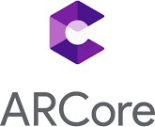

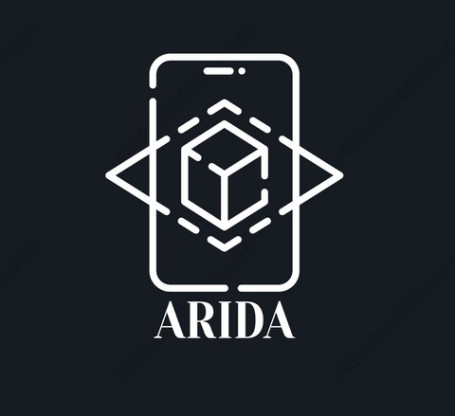

Slide 10

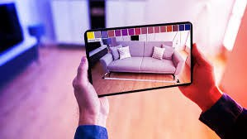
More About AR
Augmented reality (AR) holds immense potential in transforming how we interact with technology and our surroundings. By overlaying digital information onto the real world, AR enhances our perception and understanding of physical environments. From educational applications offering immersive learning experiences to retail solutions enabling virtual product try-ons, AR offers a wide range of practical uses across industries. Its ability to bridge the gap between the physical and digital realms makes AR a powerful tool for enhancing productivity, engagement, and creativity in various aspects of our lives.

Slide 11


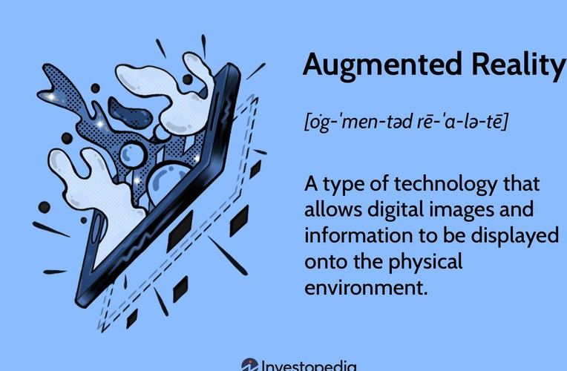
ADVANTAGES
One of the key advantages of AR is its versatility and applicability across diverse industries and use cases. In education, AR
enhances providing content,
learning experiences by interactive and
immersive visualize
allowing students to
complex concepts and engage in hands-on learning activities. In healthcare, AR facilitates surgical planning, training, and visualization, improving patient outcomes and enhancing medical education.

Slide 12

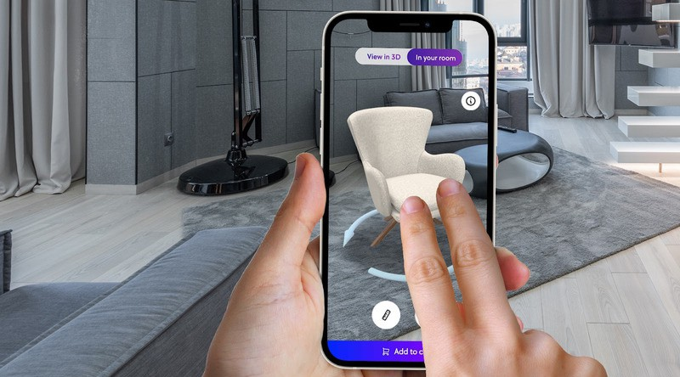

Authentication
Authentication is a crucial aspect of information security and identity management, ensuring that users are who they claim to be before granting access to resources, systems, or services. In the context of technology, authentication verifies the identity of individuals or entities seeking access to digital assets, systems, or data.
Content Creation
Content creation involves developing 3D models, animations, textures, and other digital assets that will be integrated into the AR experience. This may also involve creating scripts or algorithms for interactions, animations, and behaviors of virtual objects.

Slide 13

THANK YOU

